Slide 1
Solution of ODE/PDE using
Neural Networks
Bing Han, Lin 10/20/2020

Slide 2
TABLE OF CONTENT
01
A simple Neural Networks
02
Solving ODE/PDE with NN
03
Examples
04
Recent work

Slide 3








A simple Neural Networks (1)
$$b$$
$$x_{1}$$
$$w_{1}$$
$$ϕ$$
$$x_{2}$$
$$w_{2}$$
Input layer
Hidden layer
Output layer
$$φ (Wx+b)$$

Slide 4
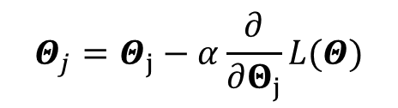

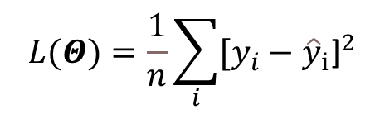
A simple Neural Networks (2)
Loss function
Loss function
$$L(Θ)=\frac{1}{n}\sum_{i}{{[y_{i}−{\hat{y}}_{i}\text{]}}^{2}}$$
Gradient descent
No
Error < $ε$
$$Θ_{j}=Θ_{j}−α\frac{∂}{∂Θ_{j}}L(Θ)$$
Done
Yes

Slide 5

Solving ODE/PDE: two possibilities
Data driven approach
Equation based approach
Generate dataset of solutions, $x →Ψ(x)$.
Train the neural network to learn the mapping, $x →\hat{Ψ}(x)$.
The train neural network is close to PDE solution.
Select interior and boundary collocation points.
Solve ODE/PDE by minimizing loss function include constrains from equations.
The train neural network is close to PDE solution.

Slide 6
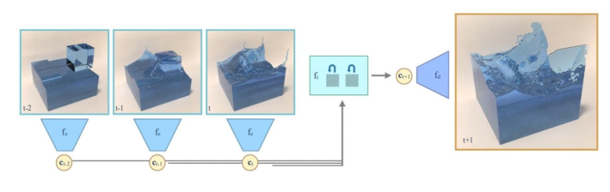
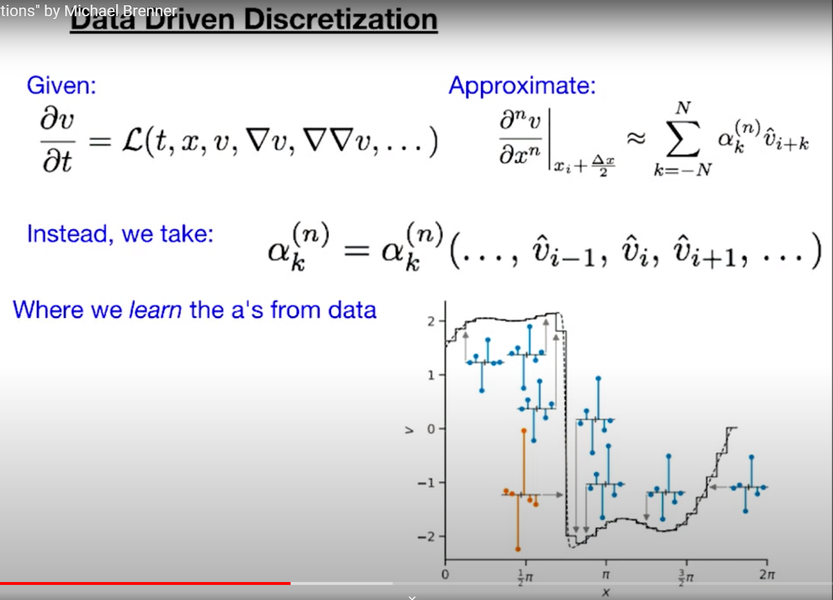

Solving ODE/PDE: two possibilities
Data driven approach
Generate dataset of solutions, $x →Ψ(x)$.
Train the neural network to learn the mapping, $x →\hat{Ψ}\left(x\right).$
The train neural network is close to the solution.
https://www.youtube.com/watch?v=9Rycnz2O-aY&t=1222s

Slide 7
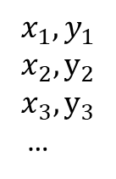
Solving ODE/PDE: two possibilities
$$x_{1},y_{1}$$
$$x_{2}, y_{2}$$
$$x_{3}, y_{3}$$
…
Equation based approach
Select interior and boundary collocation points.
Solve ODE/PDE by minimizing loss function include constrains from equations.
The train neural network is close to ODE/ PDE solution.
Governing equation
Initial conditions
Boundary conditions

Slide 8

Algorithm (1)
Dimension of the problem.
x
$$N\left(x,Θ\right)$$
y
…
…
Input layer
Hidden layer
Output layer
Artificial Neural Networks for Solving Ordinary and Partial Differential Equations, I. E. Lagaris, A. Likas and D. I. Fotiadis, 1997

Slide 9
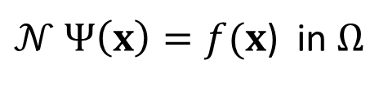

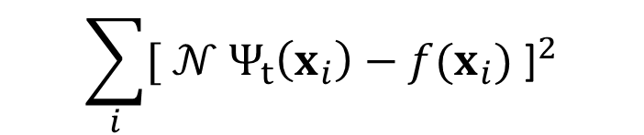
Algorithm (2)
$𝒩 Ψ\left(x\right)=f(x$) in $Ω$
Choose a form for the trial function $Ψ_{t}$ such that satisfies the ICs or BCs.
$$Ψ_{t}(x)=A\left(x\right)+F(x,N\left(x,Θ\right))$$
Satisfy the ICs or BCs.
Not contribute to ICs or BCs.
Thus, the problem is transformed into a minimization problem as follow:
$$\sum_{i}{{[ 𝒩 Ψ_{t}\left(x_{i}\right)−f(x_{i}\text{) }\text{]}}^{2}}$$
Loss function
Artificial Neural Networks for Solving Ordinary and Partial Differential Equations, I. E. Lagaris, A. Likas and D. I. Fotiadis, 1997

Slide 10



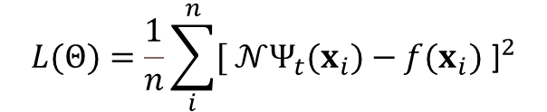
Algorithm (3)
$$N\left(x,Θ\right)$$
$$Ψ_{t}(x)=A\left(x\right)+F(x,N\left(x,Θ\right))$$
$$L(Θ)=\frac{1}{n}\sum_{i}^{n}{{[ 𝒩Ψ_{t}(x_{i})−f(x_{i}\text{) }\text{]}}^{2}}$$
No
Error < $ε$
Done
Yes
Artificial Neural Networks for Solving Ordinary and Partial Differential Equations, I. E. Lagaris, A. Likas and D. I. Fotiadis, 1997

Slide 11

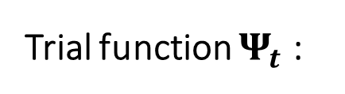

ODE Example
Problem definition:
$\frac{dΨ}{dx}+\left(x+\frac{1+3x^{2}}{1+x+x^{3}}\right)Ψ=x^{3}+2x+x^{2}\frac{1+3x^{2}}{1+x+x^{3}} in Ω$ $, x \text{∈ [0,1]}$
$$with Ψ\left(0\right)=1$$
Trial function $Ψ_{t}$ :
$$Ψ_{t}\left(x\right)=1+xN(x,Θ)$$
Satisfy the ICs or BCs.
Not contribute to ICs or BCs.

Slide 12





ODE Example
$$N\left(x,Θ\right)$$
$$Ψ_{t}\left(x\right)=1+xN(x,Θ)$$
0
1
$$x_{1},x_{2}, …$$
$$L(Θ)=\frac{1}{n}\sum_{i}^{n}{{[ 𝒩Ψ_{t}(x_{i})−f(x_{i}\text{) }\text{]}}^{2}}$$
No
Error < $ε$
Done
Yes

Slide 13
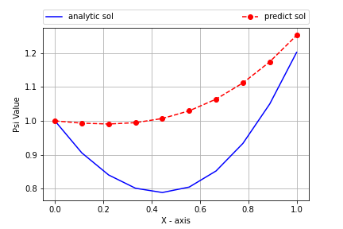
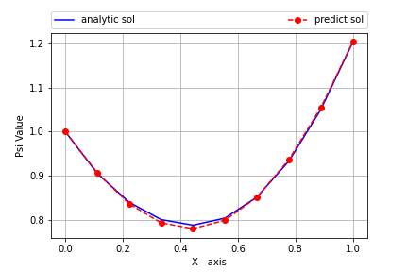
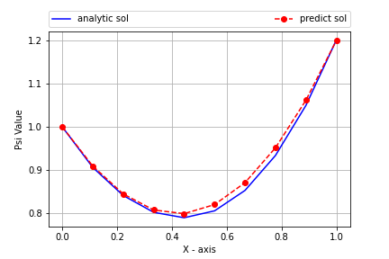
ODE Example

Slide 14
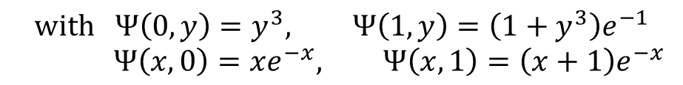
PDE Example
Problem definition:
$∇^{2}Ψ\left(x,y\right)=e^{−x}\left(x−2+y^{3}+6y\right) in Ω$ $, x,y \text{∈ [0,1]}$
$$with Ψ\left(0,y\right)=y^{3}, Ψ\left(1,y\right)=\left(1+y^{3}\right)e^{−1}$$
$$Ψ\left(x,0\right)=xe^{−x}, Ψ\left(x,1\right)=\left(x+1\right)e^{−x}$$
Trial function $Ψ_{t}$ :
$$Ψ_{t}\left(x,y\right)= A(x,y)+xy(1−x)(1−y)N(x,y,Θ)$$
Satisfy the ICs or BCs.
Not contribute to ICs or BCs.
$$A\left(x,y\right)=(1−x)y^3+x(1+y^3)e^\{−1\}+(1−y)x(e^\{−x\}−e^\{−1\})+y[(1+x)e^\{−x\}−(1−x−2xe^\{−1\})]$$

Slide 15

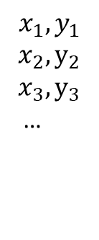


PDE Example
0
1
$$N\left(x,Θ\right)$$
$$Ψ_{t}(x)=A\left(x\right)+F(x,N\left(x,Θ\right))$$
$$x_{1},y_{1}$$
$$x_{2}, y_{2}$$
$$x_{3}, y_{3}$$
…
$$L(Θ)=\frac{1}{n}\sum_{i}^{n}{{[ 𝒩Ψ_{t}(x_{i})−f(x_{i}\text{) }\text{]}}^{2}}$$
No
Error < $ε$
Done
Yes

Slide 16
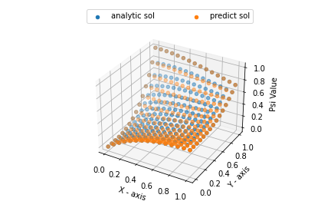
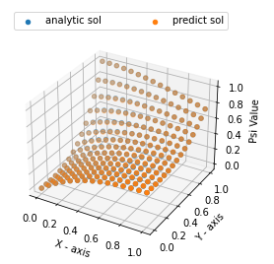
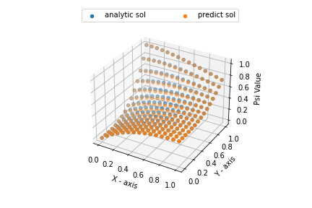
PDE Example

Slide 17
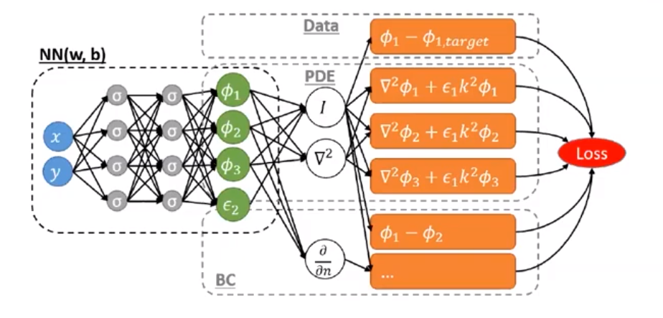
Recent Work
Better loss function.
Time marching methods.

Slide 18


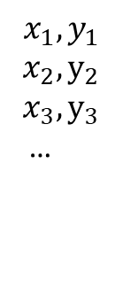

WOW
0
1
$$N\left(x,Θ\right)$$
$$x_{1},y_{1}$$
$$x_{2}, y_{2}$$
$$x_{3}, y_{3}$$
…
$$?$$
No
Other parameters for parametric analysis.
Error < $ε$
Done
Yes

Slide 19
Notes
https://leemeng.tw/deep-learning-for-everyone-understand-neural-net-and-linear-algebra.html
https://www.youtube.com/watch?v=SEhMWkgcTOI
https://github.com/maziarraissi/PINNs
https://www.youtube.com/watch?v=SEhMWkgcTOI
https://github.com/lululxvi/deepxde
https://leemeng.tw/deep-learning-for-everyone-understand-neural-net-and-linear-algebra.html
https://www.youtube.com/watch?v=U38hnksTVdE
https://www.youtube.com/watch?v=lXeVcMU1D9E
https://github.com/analysiscenter/pydens

